Slide 1


Thinking like a hacker: Security Considerations for High-Fidelity Web Archives
Originally Presented by,
Jack Cushman, Perma.cc
Ilya Kreymer, Webrecorder
http://labs.rhizome.org/presentations/security.html#/
Mohammed Nauman Siddique
Web Archiving Forensics (CS 895)
Spring, 2019

Slide 2
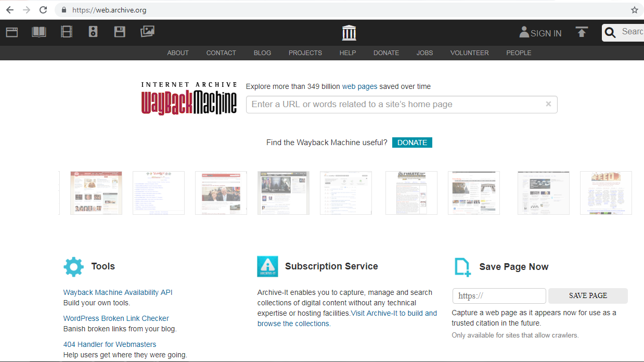
Wayback Machine
Source: https://web.archive.org/

Slide 3
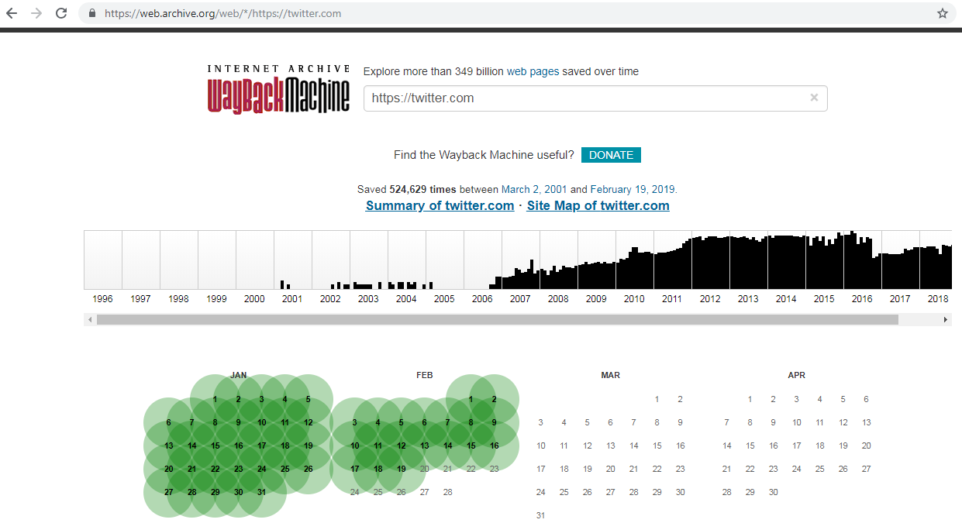
Wayback User Interface
Source: https://web.archive.org/web/*/https://twitter.com

Slide 4
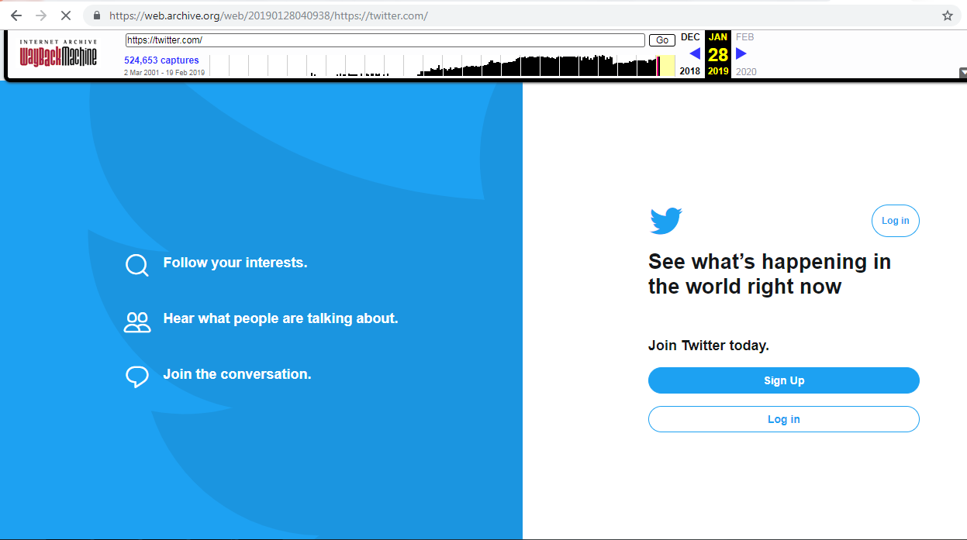
Twitter Memento
Source: https://web.archive.org/web/20190128040938/https:/twitter.com/

Slide 5
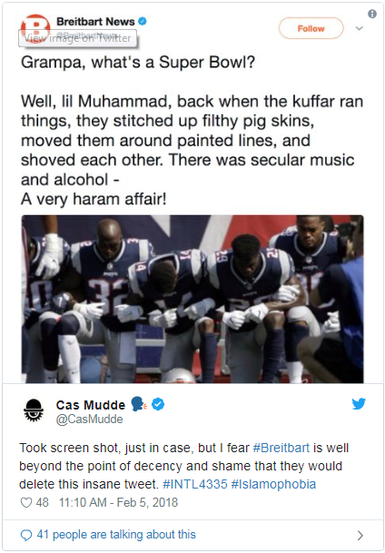
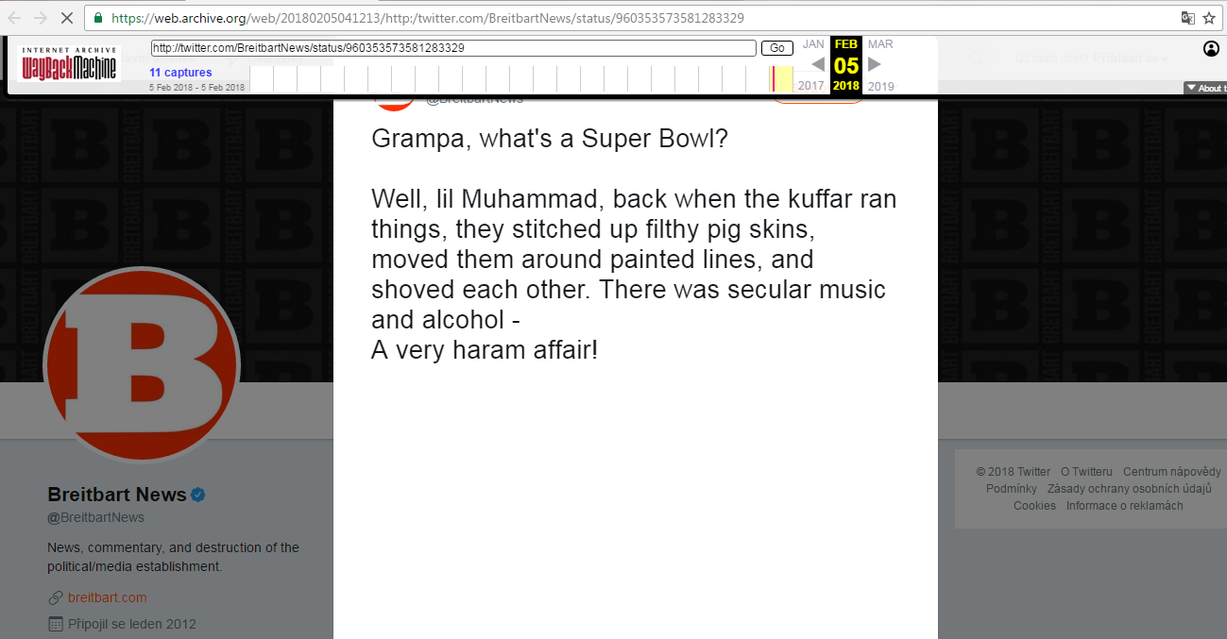
Never-Archived Resources
Missing resources from archives
Source: https://web.archive.org/web/20180205060940/http:/twitter.com/BreitbartNews/status/960353573581283329
Source: https://twitter.com/CasMudde/status/960546130684768256/

Slide 6
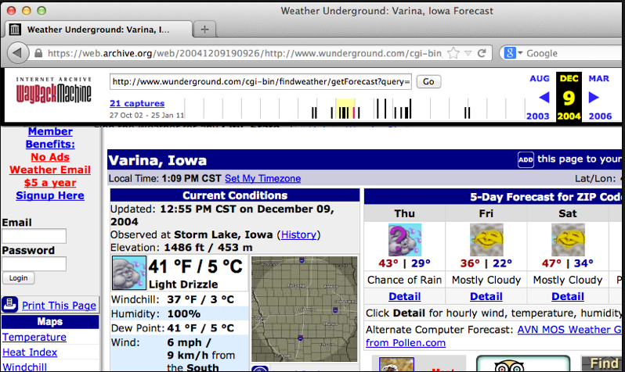
Temporal Violation (Page that never existed)
text (2004-12) says rain,
Image (2005-09)
Is clear
Source: https://ws-dl.blogspot.com/2015/12/2015-12-08-evaluating-temporal.html

Slide 7
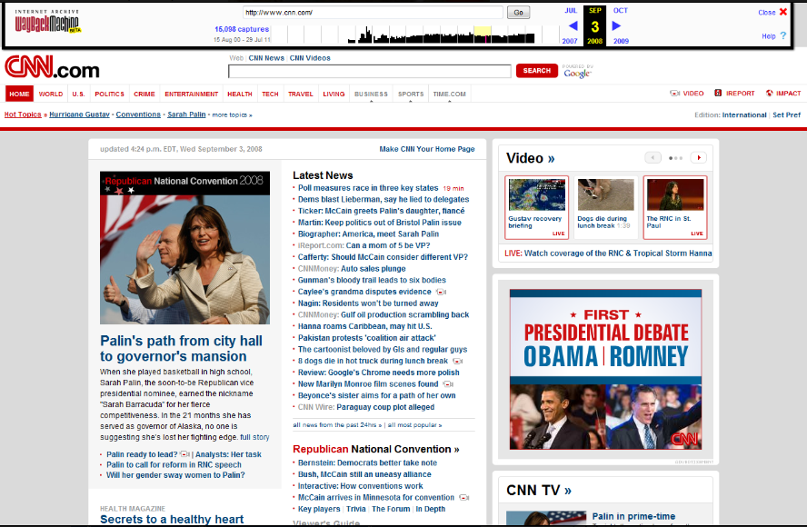
Zombies in the archive
This page is from 2008
This ad is from 2012
Source: https://ws-dl.blogspot.com/2012/10/2012-10-10-zombies-in-archives.html

Slide 8
Wayback Machine Vulnerabilities
Archival-Escapes
Same Origin Escapes
Never-Archived Resources
Nearest-Neighbor Timestamp Matching
Source: Lerner, Kohno, Roesner, 2017 https://doi.org/10.1145/3133956.3134042
/

Slide 9
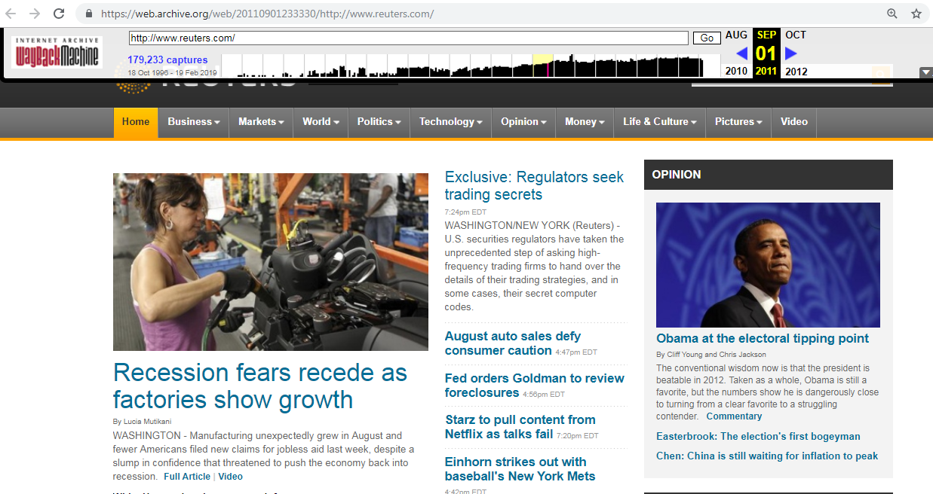
Archival-Escape Abuse
Source: https://web.archive.org/web/20110901233330/http://www.reuters.com/

Slide 10
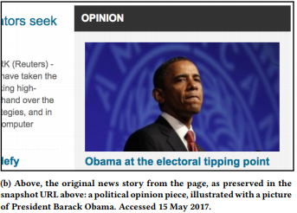
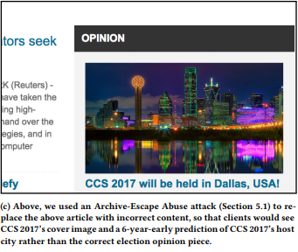
Archival capture from 2011 contains content from 2017
Page is from 2011
Hacked to show content
from 2017
Iframe content changed

Slide 11
Sequence of steps in Archival-Escape
Create a webpage with JavaScript requesting for a resource, stylesheet or script
Webpage is published
Archive it
View the snapshot using Wayback Machine
Attacker serves malicious code in response to archive-escape request
Source: Lerner, Kohno, Roesner, 2017 https://doi.org/10.1145/3133956.3134042
/

Slide 12
Mitigate Archival-Escape
Use of Content-Security-Policy header
The HTTP Content-Security-Policy response header allows web site administrators to control resources the user agent is allowed to load for a given page.
Internet Archive has fixed the issue.
Source: https://developer.mozilla.org/en-US/docs/Web/HTTP/Headers/Content-Security-Policy
Source: Source: Lerner, Kohno, Roesner, 2017 https://doi.org/10.1145/3133956.3134042/

Slide 13
Internet Archive fixed Archival-Escape
msiddique@wsdl-3102-03:/$ curl -I -L https://web.archive.org/web/20110901233330/http://www.reuters.com/
HTTP/1.1 200 OK
Server: nginx/1.15.8
Date: Wed, 20 Feb 2019 19:07:26 GMT
Content-Type: text/html;charset=UTF-8
…Deletia…
Content-Security-Policy: default-src 'self' 'unsafe-eval' 'unsafe-inline' data: blob: archive.org web.archive.org analytics.archive.org pragma.archivelab.org
X-Archive-Src: ARCHIVEIT-2438-DAILY-NKENEO-00000/ARCHIVEIT-2438-DAILY-NKENEO-20110901233234-00005-crawling206.us.archive.org-6684.warc.gz
X-App-Server: wwwb-app57

Slide 14
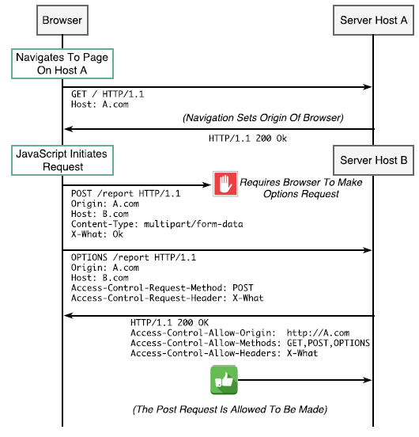
Cross-Origin Resource Sharing (CORS)
Source: Berlin, John A.. 2018. Master of Science (MS), thesis, Old Dominion University, DOI: 10.25777/n8mg-da06

Slide 15
Same-Origin Escapes
Create a webpage with iframe loading malicious code from another domain (CORS will block malicious code on live web)
Archive it
View it in the Wayback machine
Iframe and webpage both are loaded from same domain (malicious code comes into play)
Source: Lerner, Kohno, Roesner, 2017 https://doi.org/10.1145/3133956.3134042
/

Slide 16
Mitigate Same-Origin Escapes
Use iframes to isolate web archive content
Load web archive app from app domain
Load iframe content from content domain
Webrecorder example:
https://webrecorder.io/ -- app domain
https://wbrc.io/ -- content domain
Source: http://labs.rhizome.org/presentations/security.html#/

Slide 17
Same-Origin Escape + Archive-Escape
Attacker is 3rd party who embeds code in iframe of a webpage
Choose destination payload URL controlled by you and add archive-escape to the URL as src attribute of a <script> tag in the iframe
Archive it
Some time later change the content at archive-escape URL
Load the memento in WayBack Machine
Source: Lerner, Kohno, Roesner, 2017 https://doi.org/10.1145/3133956.3134042
/

Slide 18
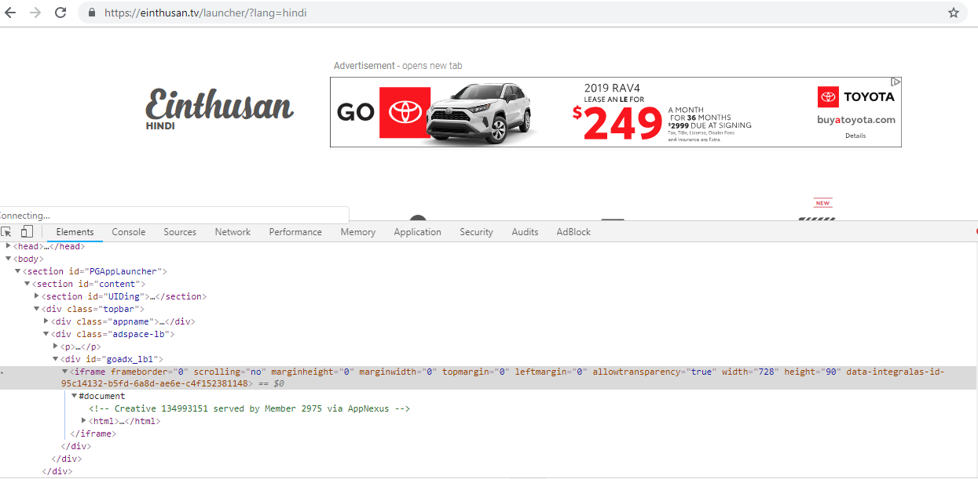
Iframe loading ads
Source: https://einthusan.tv/launcher/?lang=hindi

Slide 19
Archives allow Same Origin Policy
msiddique@wsdl-3102-03:/$ curl -I -L https://web.archive.org/web/20190220192222/https://einthusan.tv/launcher/?lang=hindi
HTTP/1.1 200 OK
Server: nginx/1.15.8
Date: Wed, 20 Feb 2019 19:22:52 GMT
…Deletia…
X-Archive-Orig-content-security-policy: upgrade-insecure-requests
…Deletia…
Content-Security-Policy: default-src 'self' 'unsafe-eval' 'unsafe-inline' data: blob: archive.org web.archive.org analytics.archive.org pragma.archivelab.org
X-Archive-Src: live-20190220190940-wwwb-app53.us.archive.org.warc.gz
X-App-Server: wwwb-app100

Slide 20
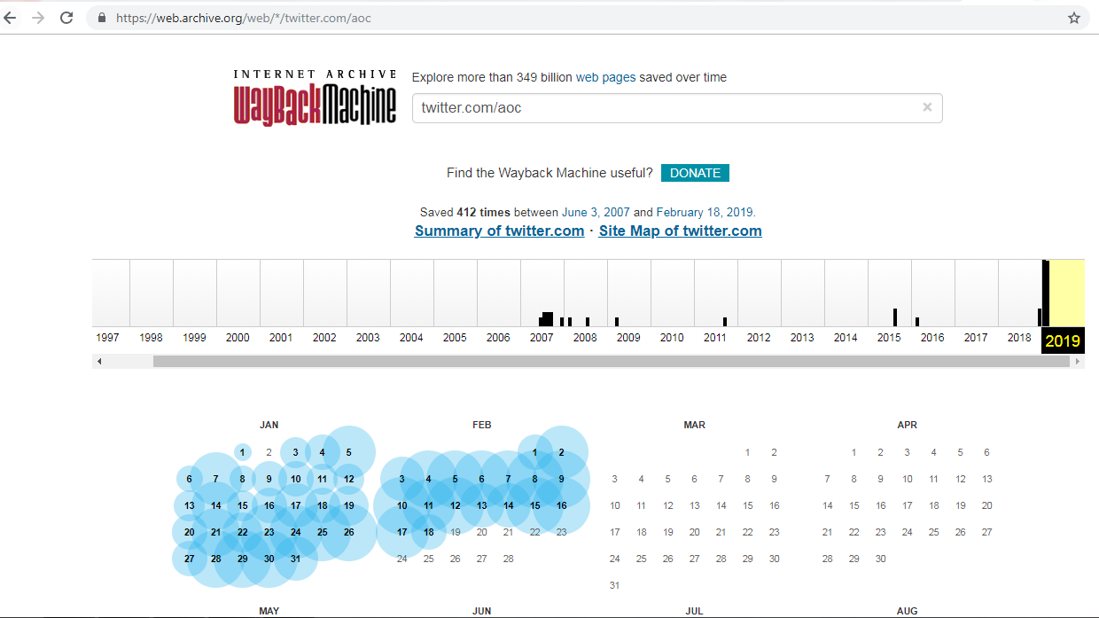
Nearest-Neighbor Timestamp Matching
Source: https://web.archive.org/web/*/twitter.com/aoc

Slide 21
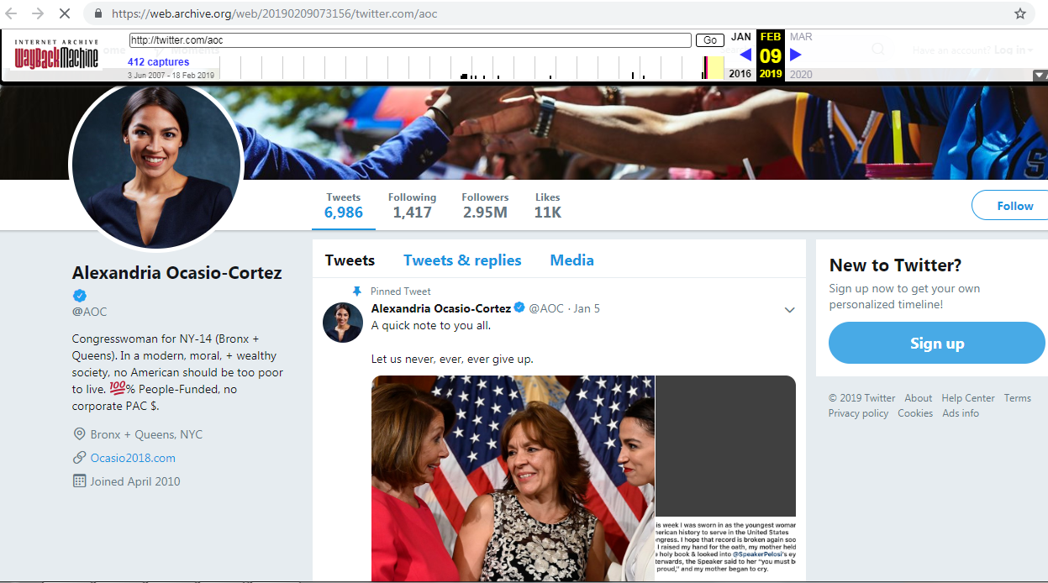
AOC Twitter Page
Source: https://web.archive.org/web/20190209073156/twitter.com/aoc

Slide 22
Anachronism Injection
Requested Timestamp

Slide 23
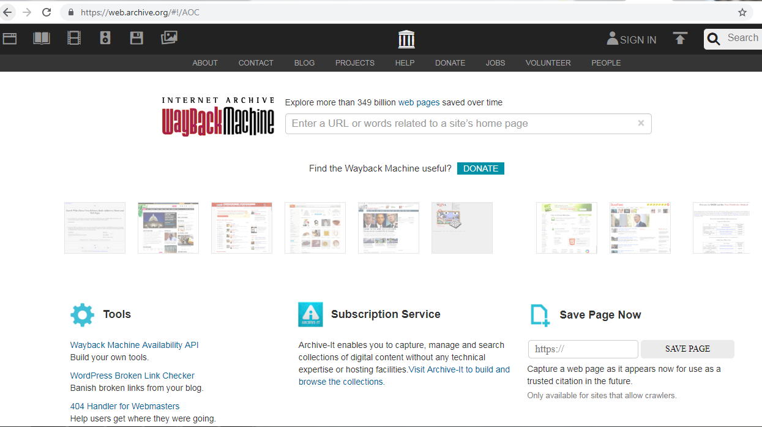
Memento for AOC from 2012
Source: https://web.archive.org/web/20120823085210/https://twitter.com/aoc

Slide 24
Curl the memento
msiddique@wsdl-3102-03:/$ curl -I -L https://web.archive.org/web/20120823085210/https://twitter.com/aoc
HTTP/1.1 302 FOUND
Date: Tue, 19 Feb 2019 15:53:14 GMT
X-Archive-Redirect-Reason: found capture at 20110903085703
Location: https://web.archive.org/web/20110903085703/http://twitter.com/AOC
…Deletia…
HTTP/1.1 200 OK
Server: nginx/1.15.8
Date: Tue, 19 Feb 2019 15:53:14 GMT
Content-Type: text/html; charset=utf-8
Content-Length: 45176
Connection: keep-alive
X-Archive-Orig-status: 200 OK
X-Archive-Orig-content-length: 38690
…Deletia…

Slide 25
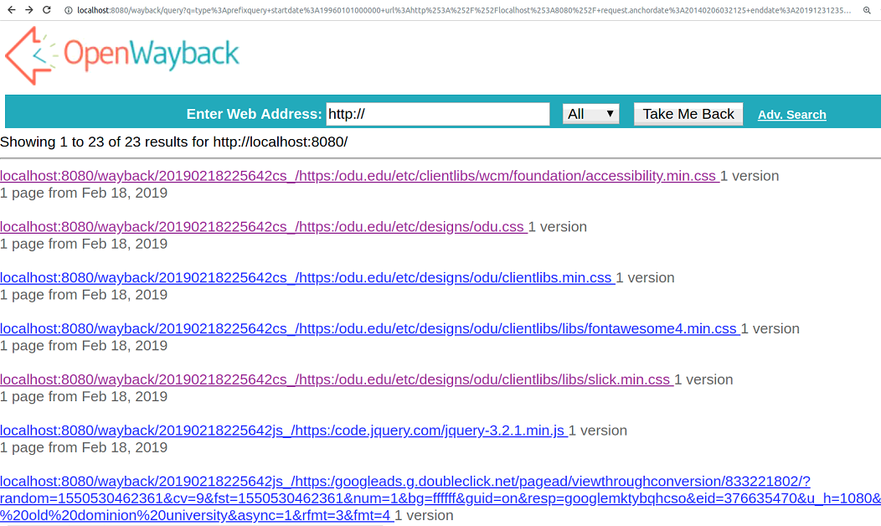
Archiving Local Content

Slide 26
How to mitigate archiving local content?
Do not allow local ip range captures
Restrict to http(s) protocol
Run capture in isolated container/VM
Source: http://labs.rhizome.org/presentations/security.html#/

Slide 27
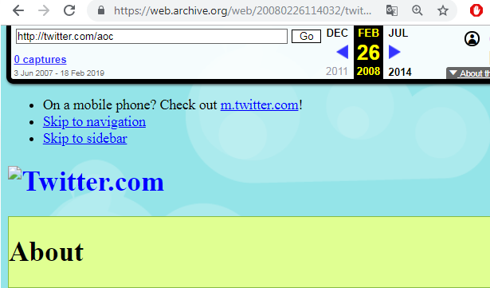
Banner Spoofing

Slide 28
Mitigate Banner Spoofing
Don't inject banner into replay frame
Use X-Frame-Options header to limit embedding
Serve from separate content domain
Use iframe sandbox (more restrictive)
Source: http://labs.rhizome.org/presentations/security.html#/

Slide 29
For further reading
DHSR’s Blogpost:
https://blog.dshr.org/2017/09/attacking-users-of-wayback-machine.html
John Berlin’s Masters Thesis:
10.25777/n8mg-da06
ACM SIGSAC 2017 paper:
https://doi.org/10.1145/3133956.3134042

